Slide 1
Introducing Retrieval Algorithms
Scott O’Hara
Metrowest Developers Machine Learning Group
05/12/2021

Slide 2
References
The material for this talk is primarily drawn from the notes, slides and lectures of the courses and book below:
Machine Learning Foundations: A Case Study Approach
University of Washington, Prof. Emily Fox & Prof. Carlos Guestrin
https://www.coursera.org/learn/ml-foundations
CSE/STAT 416 - Intro to Machine Learning Spring 2018
University of Washington, Prof. Emily Fox, Spring 2018
https://courses.cs.washington.edu/courses/cse416/18sp/index.html
University of Washington, Sewoong Oh, Spring 2019
https://courses.cs.washington.edu/courses/cse416/19sp/index.html
University of Washington, Vinitra Swamy, Summer 2020
https://courses.cs.washington.edu/courses/cse416/20su/index.html

Slide 3
Last Time: Recommender Systems

Slide 4
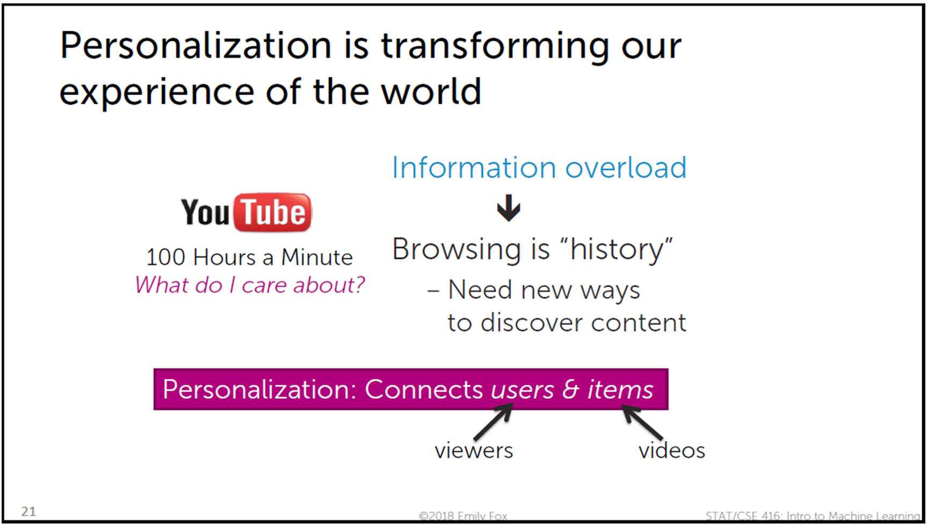

Slide 5
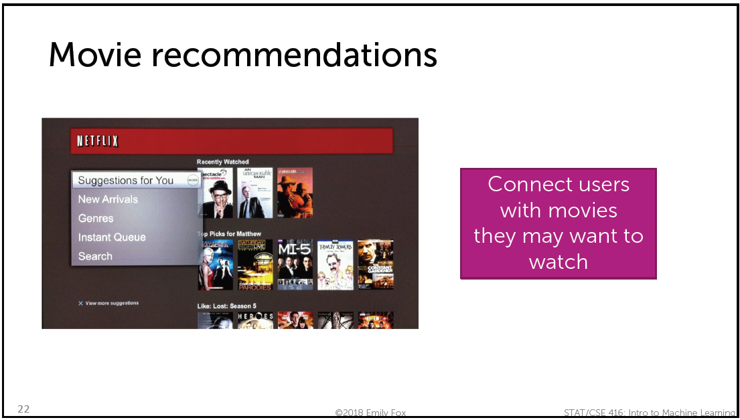

Slide 7
Approaches to Building a Recommender System
Solution 0: Popularity
Solution 1: Content-based Filtering (Classification Model)
Solution 2: Collaborative Filtering (People who bought this also bought …)
Solution 3: Discovering Hidden Structure by Matrix Factorization
Bringing it all together: Featurized Matrix Factorization

Slide 9


Slide 10
But sometimes, the most similar items are exactly what you are looking for…

Slide 11
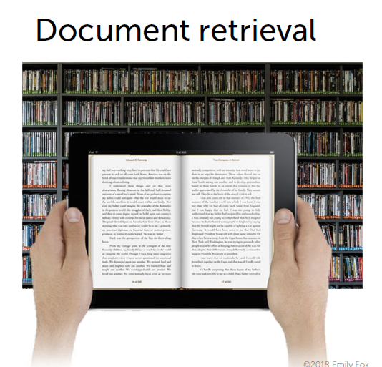

Slide 14
Three Retrieval Algorithms
KNN – K Nearest Neighbors
The basic retrieval idea. Easy to understand, but inefficient.
KD-Trees – K-dimensional Trees
More efficient than KNN, but subject to curse of dimensionality.
LSH – Locality Sensitive Hashing
Hash items so that that similar items are likely to end up in the same bins. Much more efficient than KD-Trees and curse of dimensionality is much less a problem.

Slide 15
Presentation Order
KNN – K Nearest Neighbors
The basic retrieval idea. Easy to understand, but inefficient.
LSH – Locality Sensitive Hashing
Hash items so that that similar items are likely to end up in the same bins. Much more efficient than KD-Trees and curse of dimensionality is much less a problem.
KD-Trees – K-dimensional Trees
More efficient than KNN, but subject to curse of dimensionality.

Slide 16
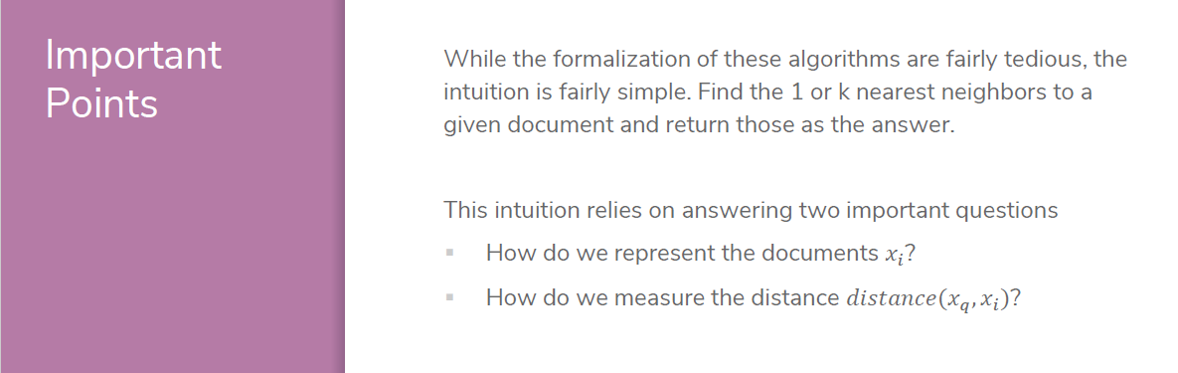
Reference: CSE/STAT 416 Intro to Machine Learning, Summer 2020, University of Washington, Instructor: Vinitra Swamy

Slide 17
Two Important Questions
Document Representation
Bag of words
TF-IDF
Similarity/Distance Measures
Euclidean distance
Similarity represented by vector dot products
Cosine similarity
Many more …

Slide 18
Reference: CSE/STAT 416 Intro to Machine Learning, Summer 2020, University of Washington, Instructor: Vinitra Swamy

Slide 19
Reference: CSE/STAT 416 Intro to Machine Learning, Summer 2020, University of Washington, Instructor: Vinitra Swamy

Slide 20
Reference: CSE/STAT 416 Intro to Machine Learning, Summer 2020, University of Washington, Instructor: Vinitra Swamy

Slide 21
Reference: CSE/STAT 416 Intro to Machine Learning, Summer 2020, University of Washington, Instructor: Vinitra Swamy

Slide 22
Reference: CSE/STAT 416 Intro to Machine Learning, Summer 2020, University of Washington, Instructor: Vinitra Swamy

Slide 23
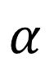
cos(0) = 1 (different)
cos(90) = 0 (similar)
$$α$$
Reference: CSE/STAT 416 Intro to Machine Learning, Summer 2020, University of Washington, Instructor: Vinitra Swamy

Slide 24
(raw counts)
Reference: CSE/STAT 416 Intro to Machine Learning, Summer 2020, University of Washington, Instructor: Vinitra Swamy

Slide 25
(using TF-IDF)
Reference: CSE/STAT 416 Intro to Machine Learning, Summer 2020, University of Washington, Instructor: Vinitra Swamy

Slide 26
Reference: CSE/STAT 416 Intro to Machine Learning, Summer 2020, University of Washington, Instructor: Vinitra Swamy

Slide 27
Retrieval as K-nearest neighbor search

Slide 32
Reference: CSE/STAT 416 Intro to Machine Learning, Summer 2020, University of Washington, Instructor: Vinitra Swamy

Slide 33
Reference: CSE/STAT 416 Intro to Machine Learning, Summer 2020, University of Washington, Instructor: Vinitra Swamy

Slide 34
Reference: CSE/STAT 416 Intro to Machine Learning, Summer 2020, University of Washington, Instructor: Vinitra Swamy

Slide 35
Reference: CSE/STAT 416 Intro to Machine Learning, Summer 2020, University of Washington, Instructor: Vinitra Swamy

Slide 36
Reference: CSE/STAT 416 Intro to Machine Learning, Summer 2020, University of Washington, Instructor: Vinitra Swamy

Slide 37
Retrieval with LSH (Locality Sensitive Hashing)

Slide 38
Reference: CSE/STAT 416 Intro to Machine Learning, Summer 2020, University of Washington, Instructor: Vinitra Swamy

Slide 39
Reference: CSE/STAT 416 Intro to Machine Learning, Summer 2020, University of Washington, Instructor: Vinitra Swamy

Slide 40
Reference: CSE/STAT 416 Intro to Machine Learning, Summer 2020, University of Washington, Instructor: Vinitra Swamy

Slide 41
Reference: CSE/STAT 416 Intro to Machine Learning, Summer 2020, University of Washington, Instructor: Vinitra Swamy

Slide 42
Reference: CSE/STAT 416 Intro to Machine Learning, Summer 2020, University of Washington, Instructor: Vinitra Swamy

Slide 43
Reference: CSE/STAT 416 Intro to Machine Learning, Summer 2020, University of Washington, Instructor: Vinitra Swamy

Slide 44
Reference: CSE/STAT 416 Intro to Machine Learning, Summer 2020, University of Washington, Instructor: Vinitra Swamy

Slide 45
?
Reference: CSE/STAT 416 Intro to Machine Learning, Summer 2020, University of Washington, Instructor: Vinitra Swamy

Slide 46
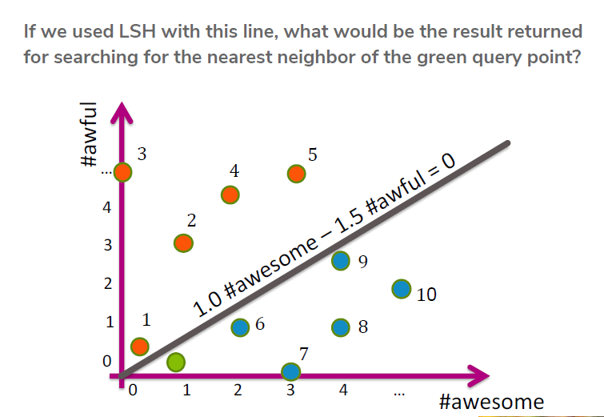
8
Reference: CSE/STAT 416 Intro to Machine Learning, Summer 2020, University of Washington, Instructor: Vinitra Swamy

Slide 48
Reference: CSE/STAT 416 Intro to Machine Learning, Summer 2020, University of Washington, Instructor: Vinitra Swamy

Slide 49
Reference: CSE/STAT 416 Intro to Machine Learning, Summer 2020, University of Washington, Instructor: Vinitra Swamy

Slide 50
Reference: CSE/STAT 416 Intro to Machine Learning, Summer 2020, University of Washington, Instructor: Vinitra Swamy

Slide 51
Reference: CSE/STAT 416 Intro to Machine Learning, Summer 2020, University of Washington, Instructor: Vinitra Swamy

Slide 52
Reference: CSE/STAT 416 Intro to Machine Learning, Summer 2020, University of Washington, Instructor: Vinitra Swamy

Slide 53
Reference: CSE/STAT 416 Intro to Machine Learning, Summer 2020, University of Washington, Instructor: Vinitra Swamy

Slide 54
Reference: CSE/STAT 416 Intro to Machine Learning, Summer 2020, University of Washington, Instructor: Vinitra Swamy

Slide 55
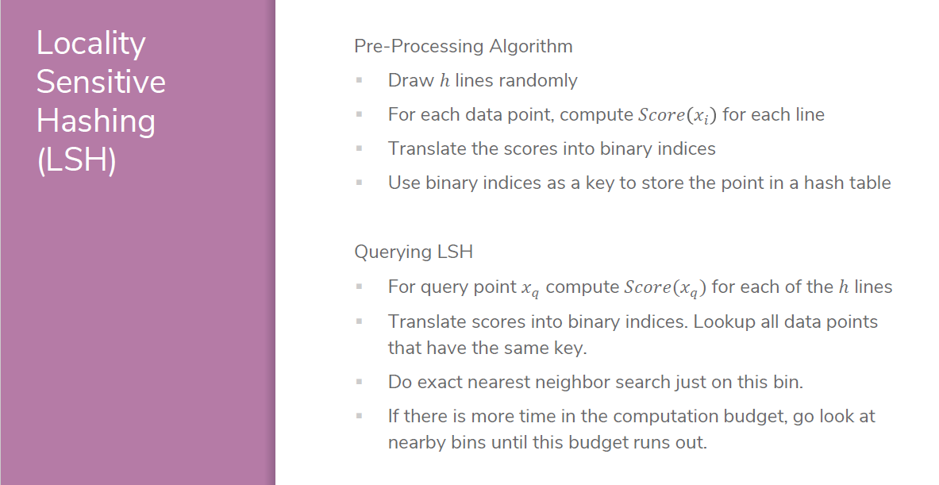
Reference: CSE/STAT 416 Intro to Machine Learning, Summer 2020, University of Washington, Instructor: Vinitra Swamy

Slide 56
Retrieval with KD-Trees (K-dimensional Trees)

Slide 57
Introducing Retrieval Algorithms
Scott O’Hara
Metrowest Developers Machine Learning Group
05/12/2021

Slide 58
Reference: CSE/STAT 416 Intro to Machine Learning, Spring 2019, University of Washington, Instructor: Sewoong Oh
Reference: CSE/STAT 416 Intro to Machine Learning, Summer 2020, University of Washington, Instructor: Vinitra Swamy
Reference: CSE/STAT 416 Intro to Machine Learning, Summer 2020
University of Washington, Instructor: Vinitra Swamy

